Slide 1
Circular Construction
We live Material Circularity!

Slide 2
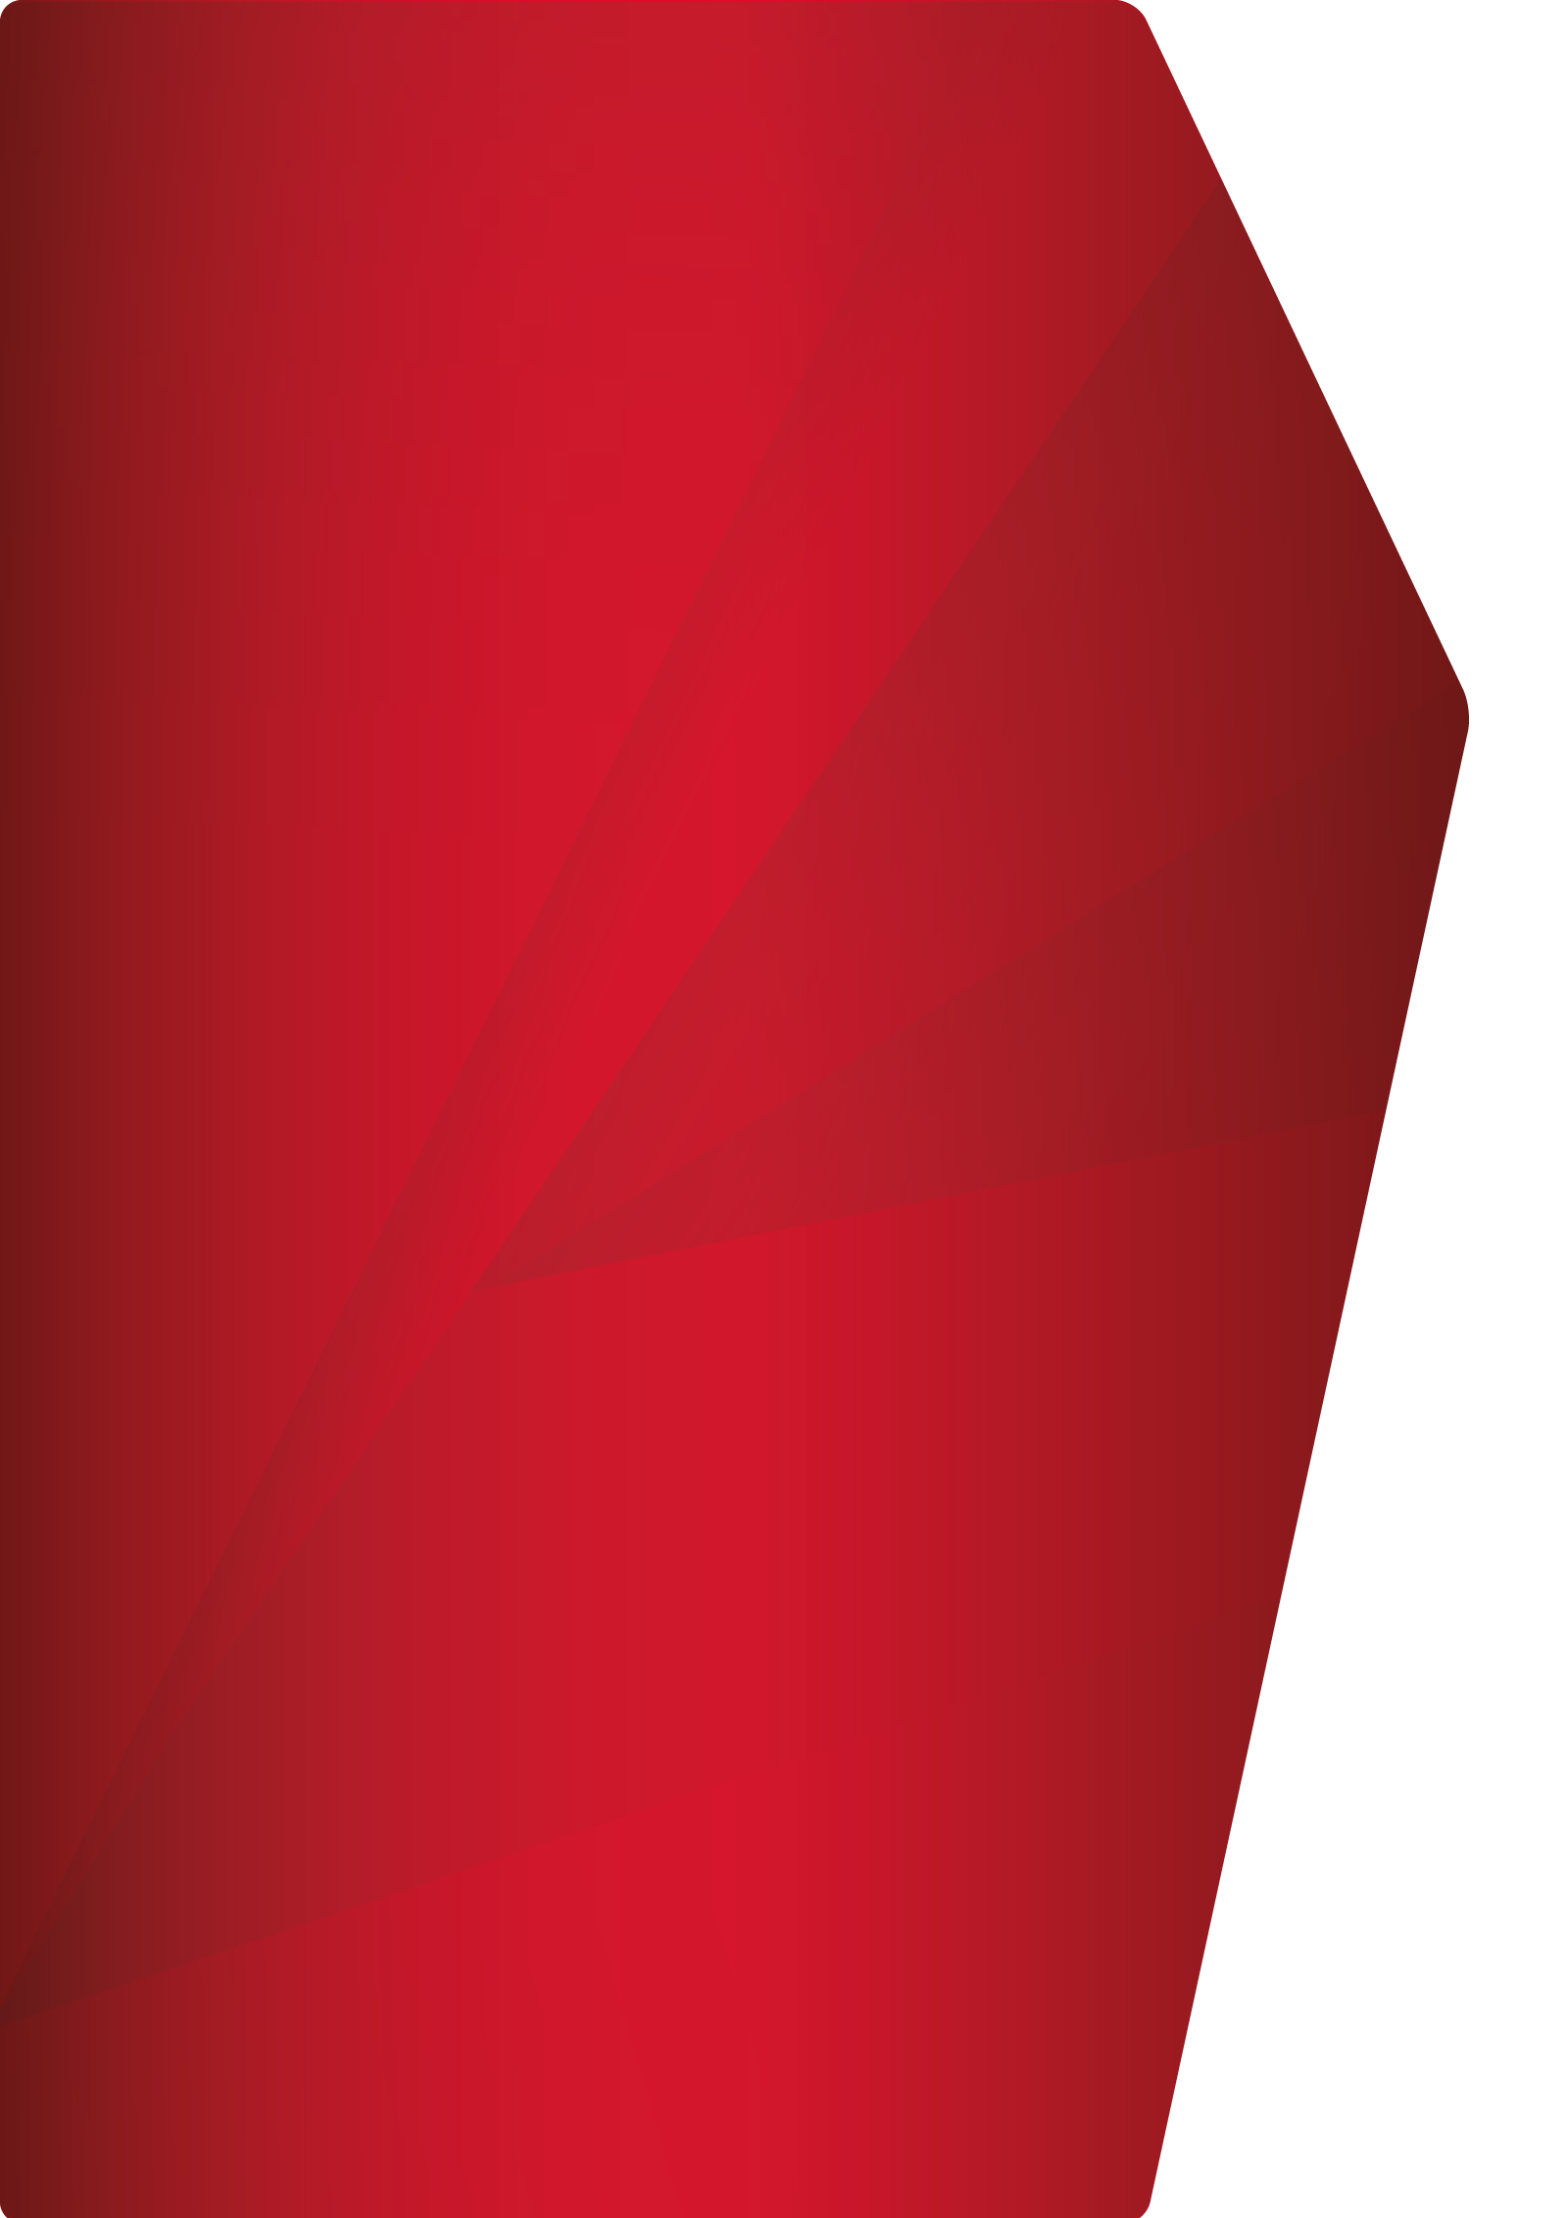
Our Visions and motivations for circular economy
Our Vision since 2008: „Waste-free and climate-neutral production“
Waste and climate: Disposal costs and landfill capacities
Resource use and security of supply: FDG gypsum and metals
Responsibility: Construction industry as a source of 50 % of waste generated in Europe
Statistisches Bundesamt / 2021 IW Medien /iwd

Slide 3
Environmental Milestones so far
2010
2013
Endowed Chair of „Sustainable Building“ at the
THD Deggendorf
2015
1993
2008
Service Department Green Building, first EPD, first emission measurements for systems according to AgBB
2018
Establishment of a certified environmental management system
Campaign
„Besser Bauen für Mensch und Umwelt“
DGNB
Founding member
Health Passports for CUBE
(Indoor air quality, comfort)
2016
2020
2007
First Cradle to Cradle Certified®
Product certification
Life Cycle Assessment key figures for each production site
First DGNB and LEED Projects
2009
2014
Vision: CO2 neutral and waste free
2011
First verified EPD, Establishment of a certified energy management system
Erste eigene
Ökobilanzierung von Produktionsstandorten

Slide 4
Ongoing Environmental Milestones
Cradle to Cradle Certified® Product standard
Product improvements to reach higher certification levels
Plastic free
Packaging
Automatically generated Life Cycle Assessment
per product/system
New business models
Return system, leasing, secondary market …
active designer / Kennedy member in the Madaster network
Climate neutral
Through circular economy
Using results of Research Project
RessProKa
Closing resource-efficient product cycles
Direct circulation
for calcium sulfate products
Research Project HORIZON 2020
Circulation platform for data exchange
New study programm
THD
Buidling products / processes

Slide 5
Circular Material
and Product management
Material circularity with Lindner

Slide 6
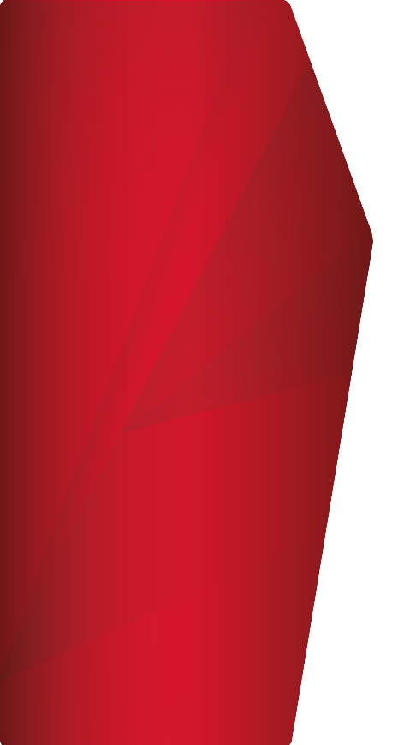
Conserve
After professional installation, the original product is used and maintained in the location for the longest possible period of time.
The product is given optimum value in this process.
The conservation of the functional quality is guaranteed by services in the form of maintenance or repair.

Slide 7
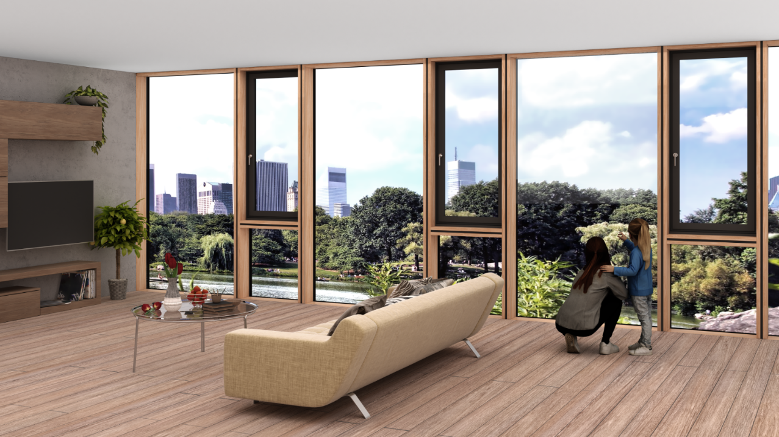
Product example
Concepts for long-term conservation of our products
Facades
Element facades
Hybrid element facades
….
Durability through:
Constructive wood preservation
Correct use of materials in terms of building physics
Functional preservation through maintenance: proper cleaning, preventive repairs, inspection of hardware components.

Slide 8
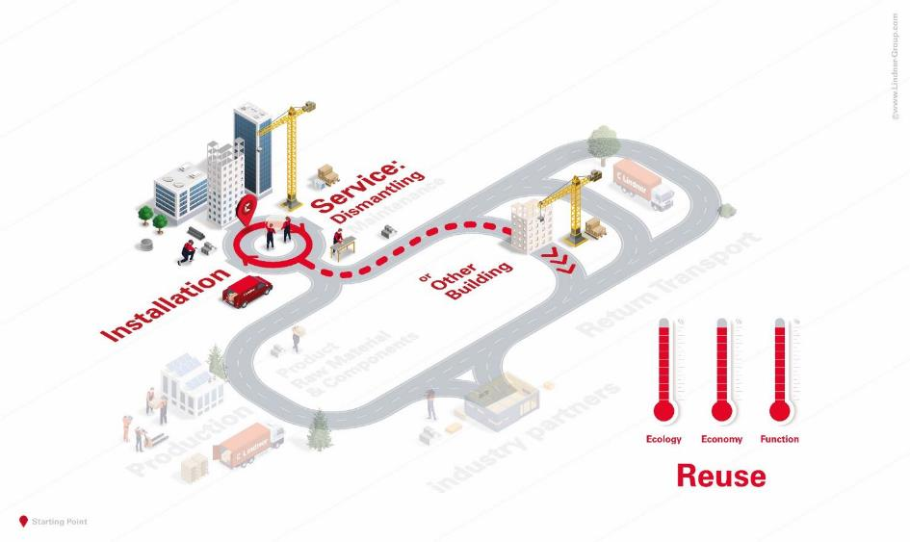
Reuse
The primary product is dismantled and directly reused without any refurbishing.
The product can be used either in the same or in a different building.

Slide 9
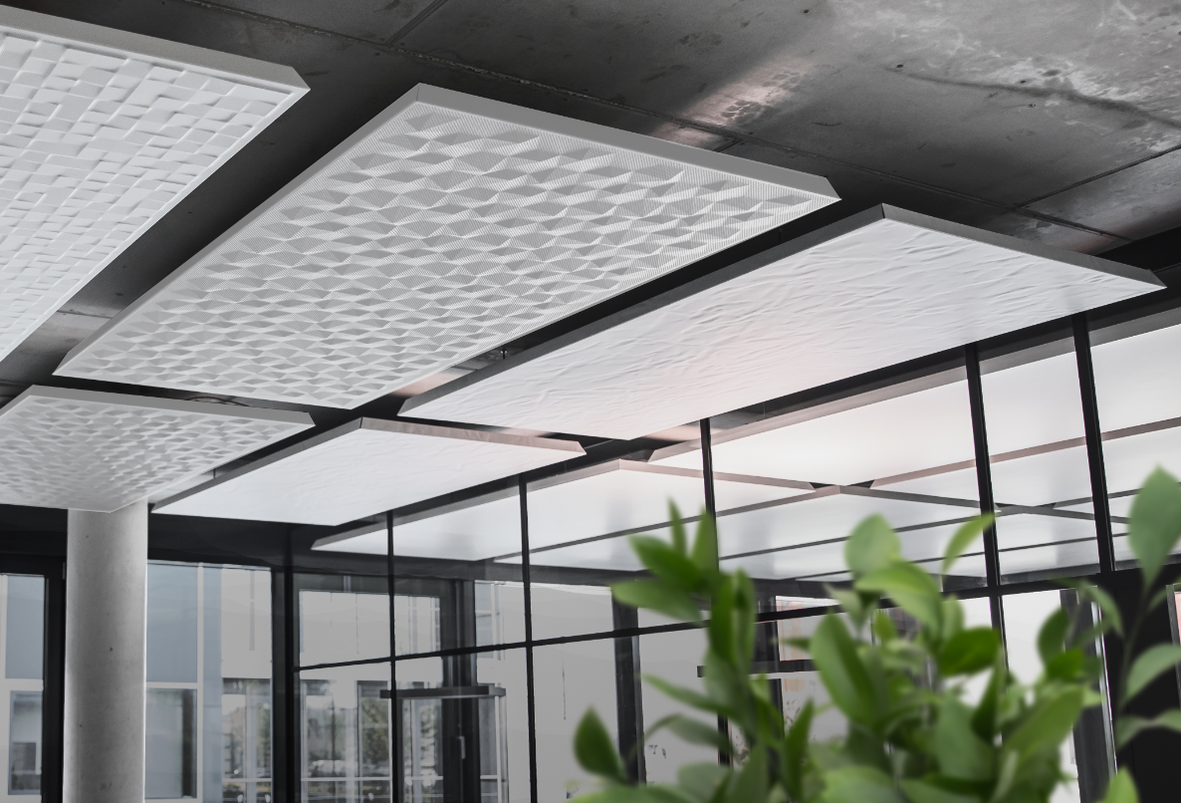
Product example
Reuseable systems
Ceiling systems
LMD metal ceilings
Plafotherm® metal ceilings
Baffle ceilings
Partition / Doors
Dismountable and displaceable partition wall systems

Slide 10
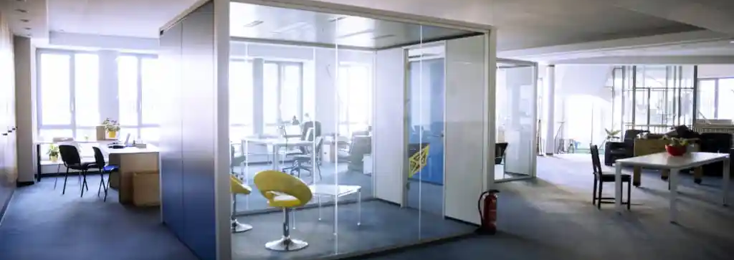
Concular Circularity Partner
Cooperation partner: Lindner Group and MUCBOOK
Lindner and MUCBOOK start a cooperation with Concular to promote resource efficiency in the construction and real estate sector. For this purpose, three sophisticated workplace concepts are looking for a new home.
Result: MUCBOOK Cubes as work, education and business spaces with creative tape design by TAPEMOSS.
Sources:
https://concular.de/de/blog/lindner-group-als-kooperationspartner-von-concular/
Notes:
Die optischen, visuellen, luftbedingten und schallschutztechnischen Konfigurationen können individuell angepasst werden, wodurch eine flexible Raumplanung ermöglicht wird.

Slide 11
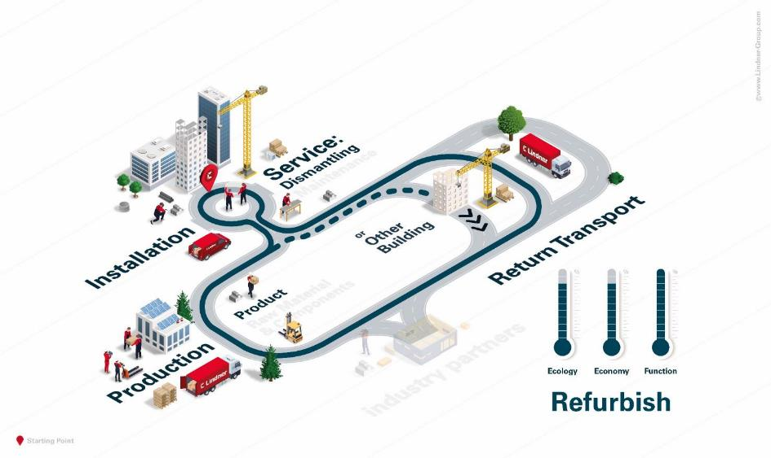
Refurbish
The primary product or components are returned to production after disassembly.
The components of the product are reprocessed and serve either the original or a new purpose.

Slide 12
Possible procedure for returning
of floor panels
Contact
Basic Information
Detailed Information
On-Site assessment
Bidding
Dismantling and transfer of the panels
Hand out of recycling certificate

Slide 13
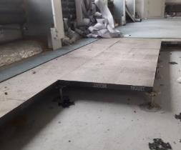
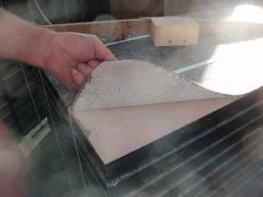
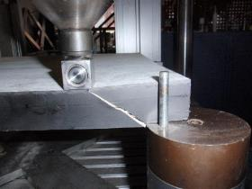
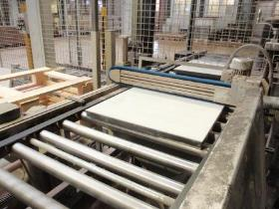
From dismantling to preparation
Panels in the refurbishment project
On site inspection
Testing the physical properties
Preparation of the surfaces

Slide 14
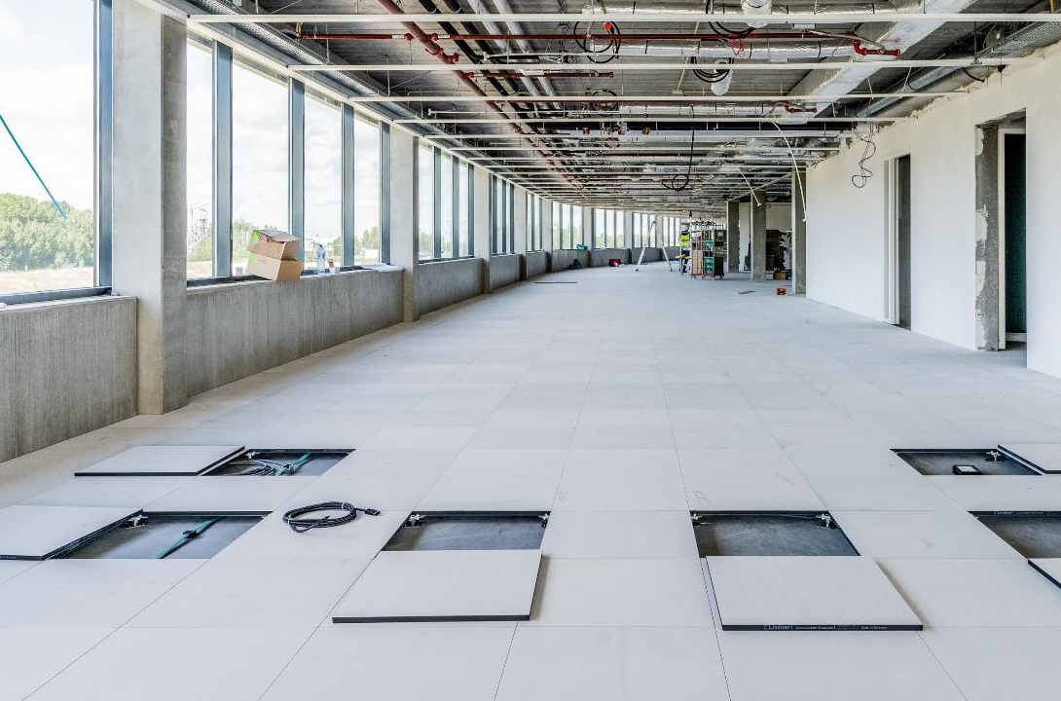
Product example
Refurbishable systems
Floors
Raised floor panels
Hollow floor panels
Refurbished floor systems
Raised floor LOOP
Hollow floor ADDLIFE

Slide 15
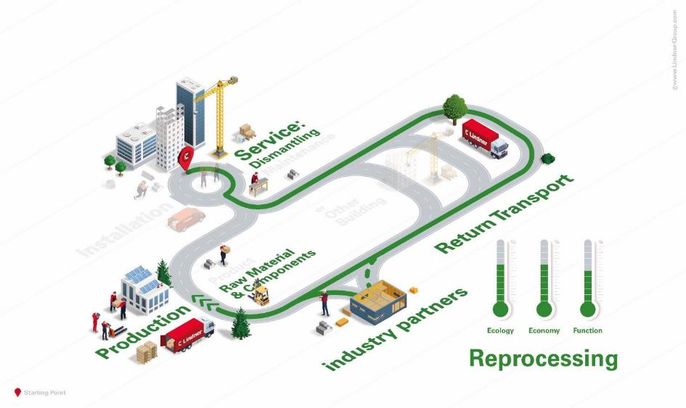
Reprocessing
The individual components of the product are separated and reused as material in the manufacturing process.
Left-over materials from production, reconstruction or construction sites are dissolved in their form and used as raw substance for the manufacture of our products.
Materials that cannot be recycled by ourselves end up in an external material or substance cycle.

Slide 16
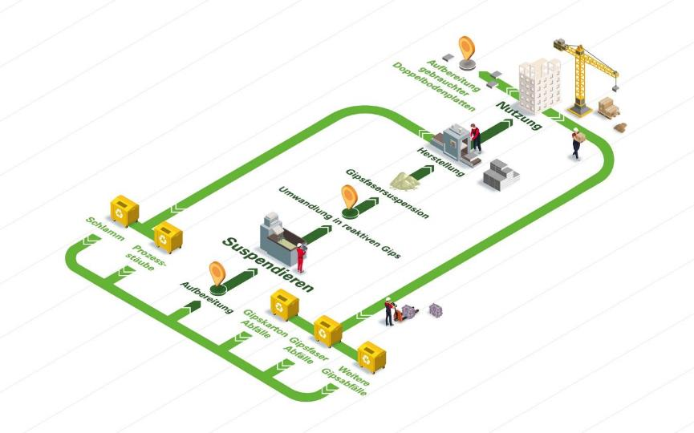
Material reprocessing
of building materials containing gypsum
In the production process: cuttings, milling dust, sediments
construction site remains: cuttings/residual materials
From deconstruction materials: deconstruction waste on the site
State-supported project (Federal Ministry for the Environment and Nature Conservation))
Gypsum panels can be processed up to 100% low-energy and thermally reactivated
Patented
method

Slide 17
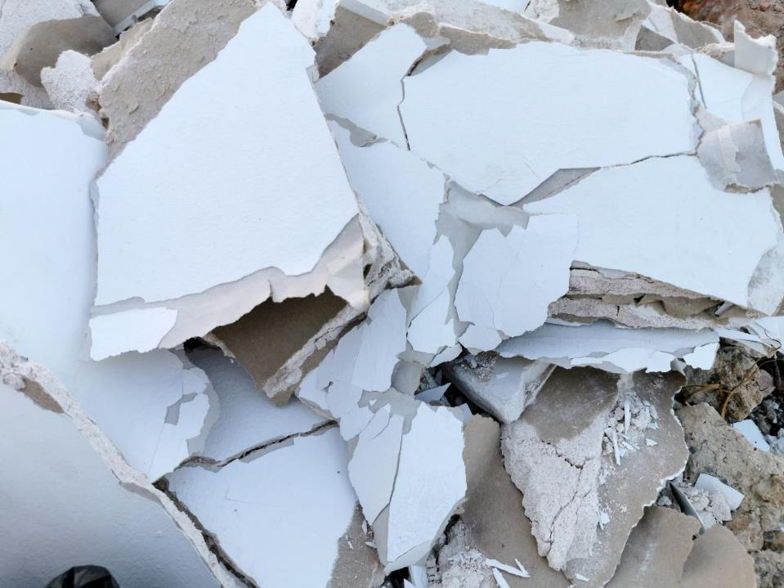
Material reprocessing
our goals
51,350 tons
of recyclable gypsum are to be returned to the production cycle annually in the future.
44,000 tons
of setting gypsum can be recovered from gypsum waste
5,270 tons of CO₂e
reduction through 53% process energy savings
50,000 tons
Primary raw materials are saved and thus less gypsum waste is deposited in landfills

Slide 18
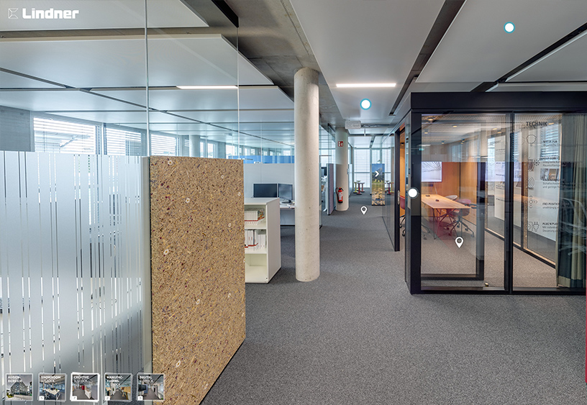
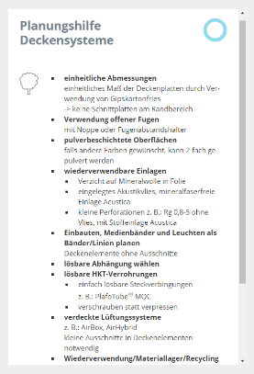
Circular Product Design
The modular design of our products is the key for closed loops.
Our virtual Showroom provides further planning aids and product benefits that allow easy reuse and recycling – take a look into the 360° Tour

Slide 19
Product informtation and Databases
Strategies and activities at Lindner

Slide 20
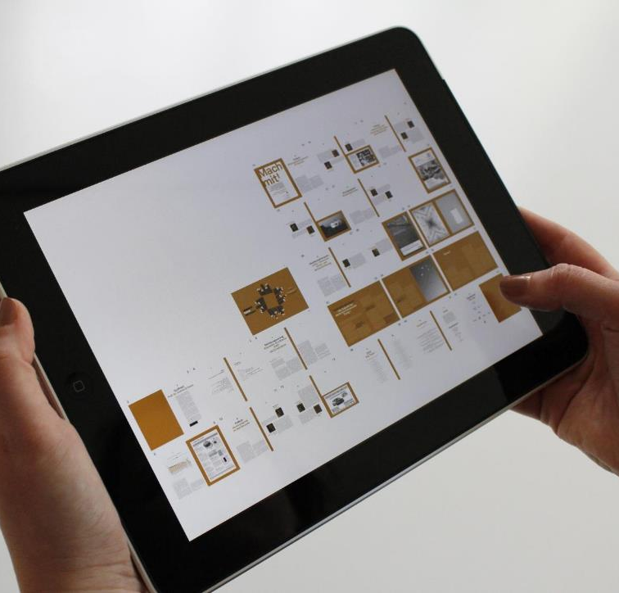
Verified sustainability
Product information
Transparent informationen about our products through:
Self declarations according DIN EN ISO 14021
Certified Environmental Product Declarations (EPD)
Proof of emissions (test reports)
Cradle to Cradle certified® Product standard
©pixabay

Slide 21
Cradle to Cradle Certified®
The System
The concept describes potentially infinite material cycles „from cradle to cradle“.
Certification is achieved by assessing the following criteria:
Material health
Product circularity
Social fairness
Water & soil stewardship
Clean air & climate protection
Certified Lindner Systems:
2 Cradle to Cradle Certified ® Gold
4 Cradle to Cradle Certified ® Silver

Slide 22
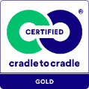
Floors
circular | sustainable
Cradle to Cradle Certified® Gold:
NORTEC aurum
LOOP aurum
Cradle to Cradle Certified® Silver:
LOOP | LOOP prime
NORTEC | NORTEC power
CEMTEC

Slide 23
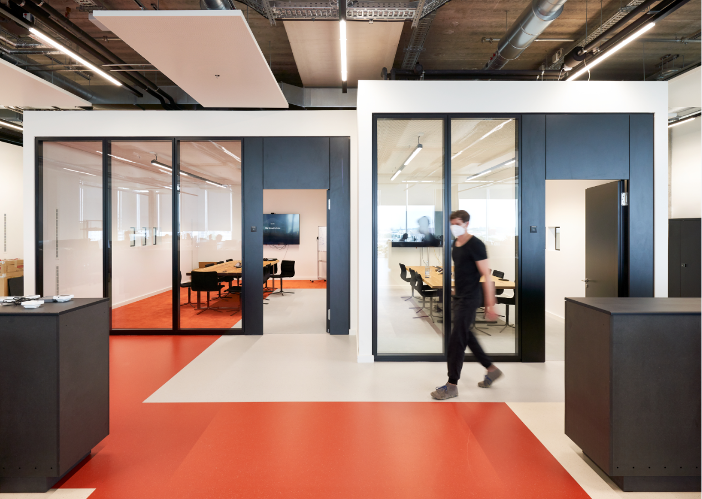
Partition/Doors
circular | sustainable
Cradle to Cradle Certified® Silber:
Lindner Life Stereo 125
Lindner Life Contour 126
Lindner Life Pure 620
ATB 42
ATB 68

Slide 24
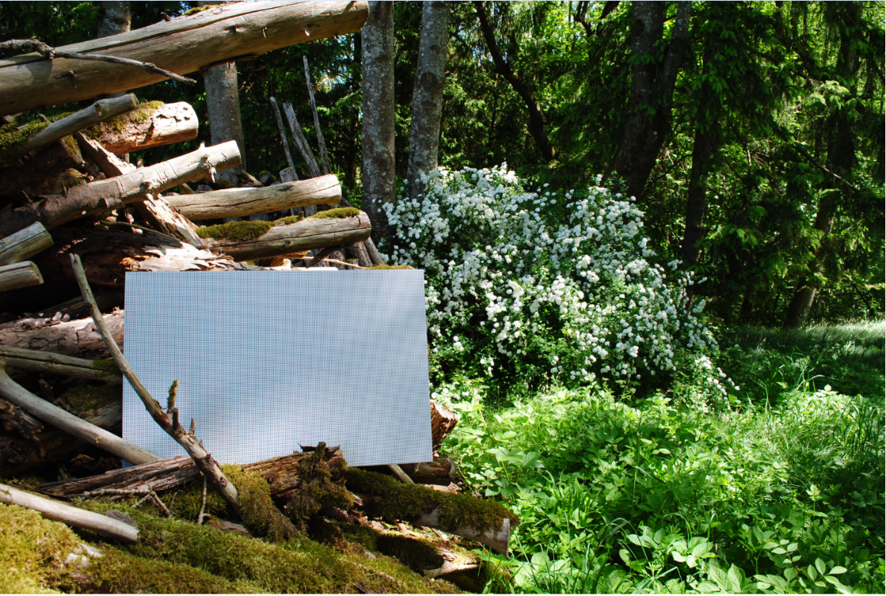
Ceilings
circular | sustainable
Cradle to Cradle Certified® Gold:
Lindner Metal Ceilings aurum
LMD Post Cap Ceilings
LMD Hook-On Ceilings
LMD Corridor Ceilings
LMD Cassette Ceilings
LMD Canopy Ceilings
LMD Baffle Ceilings
Cradle to Cradle Certified® Silber:
Plafotherm® Heated and Chilled Ceilings
Plafotherm® Post Cap Ceilings
Plafotherm® Hook-On Ceilings
Plafotherm® Corridor Ceilings
Plafotherm® Canopy Ceilings
Plafotherm® Baffle Ceilings
Plafotherm® Hybrid Ceilings

Slide 25
Digital raw material sources
as a basement for material cycles
Our products can be found in various databases:
Sustainability information for 26 Lindner product systems is well managed via Building Material Scout and can easily be used to provied evidence for „green“ construction projects.
Madaster allows the circular use of products by storing estate and material data and tracking the installation location of material („Track & Trace“)
Wert der Immobilie
Materialwert
Wert der Immobilie
Materialwert
Wert der Immobilie
Materialwert
Wert der Immobilie
Materialwert
©pixabay
Notes:
Einer der Kernpunkte des zirkulären Bauens ist es, Gebäude und die darin verbauten Produkte als Materiallager und Rohstoffquelle für zukünftige Bauvorhaben zu sehen und zu nutzen.
Detaillierte Produktinformationen in Kombination mit digitalen Werkzeugen wie „digitaler Zwilling“, digitaler Bestands-dokumentation, MATERIALPÄSSEN UND PRODUKT-DATENBANKEN dienen als Grundlage für Urban Mining und geschlossenen Materialkreisläufen in der Baupraxis.

Slide 26
Designing new
processes
Circular business models at Lindner

Slide 27
Circular Business Models
Circular Models
Status Quo „sell & forget“
Purchase without
circular option
Purchase with right to return*
Purchase with
obligation to return*
Renting / Leasing
- x %
- x %
- x %
- x %
- x %
- x %
- x %
- x %
Total price
Climate impact
Resource usage
* Ecological and economic effects depending on the use of the right of return or choice of exit option.

Slide 28
How to improve a perfect product?
Reuse it!

Slide 29
Add…
Knowledge / Evidence / Information
Cradle to Cradle Certified® products program https://www.lindner-group.com/en/expertise/green-building/cradle-to-cradle-certifiedr/
Building certification https://www.lindner-group.com/en/expertise/green-building/building-certification-systems//
Product Leasing https://www.lindner-group.com/en/expertise/green-building/product-leasing/
Environmental Product Declarations https://ibu-epd.com/en/published-epds/
Self declarations https://www.lindner-group.com/en/productfinder/
Sustainability https://www.lindner-group.com/en/company/sustainability/
References https://www.lindner-group.com/en/references/
Further Evidence / Sources:
Cradle to Cradle Certified® ist eine eingetragene Marke des Cradle to Cradle Products Innovation Institute.

